Slide 1

Internshala Internship Data Analysis
(Web Scraping and Exploratory Data Analysis)
Presented By:
Arjun Naluvala

Slide 2
INTRODUCTION
In today’s digital world, data plays a crucial role in decision-making and trend analysis.
This project focuses on collecting real-time internship data from the Internshala platform using web scraping techniques.
Since the data is not available in a structured format, web scraping is used to extract relevant information from the website.
The collected data is then cleaned, processed, and analyzed using Python libraries.

Slide 3
Exploratory Data Analysis (EDA) is performed to identify patterns, trends, and insights related to internships such as stipend, location, and duration.
This project demonstrates the end-to-end data analysis process, from data collection to visualization and insights generation.

Slide 4
PROJECT OVERVIEW
This project focuses on collecting real-time internship data from Internshala using web scraping techniques and performing Exploratory Data Analysis (EDA) to identify patterns, trends, and insights.
The dataset is not pre-downloaded; it is dynamically created using web scraping and then converted into a structured format for analysis.

Slide 5
Flow diagram:
Website → Scraping → Dataset → Analysis → Insights

Slide 6
OBJECTIVE OF THE PROJECT
To extract real-time internship data from a website
To convert unstructured data into structured format
To clean and preprocess the dataset
To perform Exploratory Data Analysis (EDA)
To identify trends in internships such as stipend, roles, and locations

Slide 7
DATA SOURCE
The data for this project is collected from the Internshala website
which is a popular platform for internship opportunities in India.
Website: https://internshala.com/internships
The website does not provide a direct option to download data in a structured format such as CSV or Excel.
Therefore, web scraping is used to extract the required information from the website’s HTML structure.

Slide 8
The website does not provide a direct option to download data in a structured format such as CSV or Excel.
Therefore, web scraping is used to extract the required information from the website’s HTML structure.
The dataset includes details such as internship title, company name, location, stipend, and duration.

Slide 9
TOOLS AND TECHNOLOGIES USED
Python
Requests (for sending HTTP requests)
BeautifulSoup (for parsing HTML data)
Pandas (for data manipulation)
Matplotlib (for visualization)
Time (for delay handling)

Slide 10
Importing Required Libraries
To perform web scraping and data analysis, several Python libraries are used:
The requests library is used to send HTTP requests and fetch the webpage content
The BeautifulSoup library is used to parse and extract data from HTML
The pandas library is used for data manipulation and analysis
The numpy library is used for numerical operations
The matplotlib and seaborn libraries are used for data visualization
These libraries form the foundation for both data collection and analysis in this project.

Slide 11
What is Web Scraping
Web scraping is a technique used to extract data from websites.
It involves sending requests to a webpage, retrieving its HTML content, and then extracting relevant information from that content.
Web scraping is particularly useful when data is not available in a structured format or cannot be directly downloaded. By converting raw HTML data into a structured dataset, it enables further analysis and insights.
In this project, web scraping is used to collect internship data from the Internshala website.

Slide 12
WEB SCRAPING PROCESS
Send request to website using Requests library
Parse HTML content using BeautifulSoup
Identify required tags and classes

Slide 13
Extract data such as
location — does city affect stipend?
Duration months
Skills required
Actively hiring
Internship title
Company name
Posted time
Repeat process for multiple pages

Slide 14
Understanding HTML Structure
Webpages are built using HTML, which consists of nested elements such as tags, classes, and attributes.
Each internship listing on the Internshala website is contained within a specific HTML structure.
By inspecting the webpage, we identify that each internship is stored inside a container (div tag) with a specific class name.
Understanding this structure is essential because it helps in accurately locating and extracting the required data fields.

Slide 15
Parsing HTML Content
After retrieving the HTML content, it needs to be parsed to extract meaningful information.
The BeautifulSoup library is used to parse the HTML content and convert it into a structured format that can be easily navigated.
It allows us to search for specific tags and classes and extract the required data.
This step simplifies the process of locating internship details within the webpage.

Slide 16
Extracting Internship Cards
Once the HTML is parsed, the next step is to extract all internship listings.
Each internship is identified using a specific HTML tag and class.
In this project, all internship cards are extracted using the div tag with the class name corresponding to individual internship listings.
Each extracted card contains complete information about one internship, including title, company, location, stipend, and duration.

Slide 17
Extracting Internship Title
After identifying the internship cards, the next step is to extract specific details from each card.
The internship title is one of the most important fields. Using BeautifulSoup, the title is extracted by locating the appropriate HTML tag within each internship card.
The .find() method is used to locate the tag, and .text.strip() is used to clean and extract the text.
This ensures that the title is stored in a clean and readable format for further analysis.

Slide 18
Extracting Company Name
The company name is another key attribute that is extracted from each internship card.
Similar to the title extraction, the company name is located using specific HTML tags and class names.
The extracted text is cleaned to remove extra spaces or unwanted characters.
This field helps in analyzing which companies are actively offering internships.

Slide 19
Extracting Location
The location of the internship is extracted from each listing.
In some cases, internships may have multiple locations or remote options.
The extraction is done by identifying the relevant HTML elements and collecting the location text.
Special care is taken to handle cases where the location field might be missing or structured differently.
This field is important for analyzing geographical trends in internship opportunities.

Slide 20
Extracting Stipend
The stipend information is extracted as text from each internship listing.
However, the stipend values are not always in a clean numerical format.
They may include symbols, ranges, or text descriptions.
Therefore, the extracted stipend data requires further cleaning before it can be used for analysis.

Slide 21
However, the stipend values are not always in a clean numerical format.
They may include symbols, ranges, or text descriptions.
Therefore, the extracted stipend data requires further cleaning before it can be used for analysis.
This field plays a crucial role in understanding compensation trends.

Slide 22
Extracting Duration
The duration of the internship is extracted from the details section of each listing.
This information helps in understanding how long internships typically last and whether duration has any impact on stipend.
The extracted duration values are stored as text and later used in analysis.

Slide 23
Handling Missing Data During Scraping
While scraping data, not all internship listings contain complete information.
Some fields may be missing or structured differently.
To handle this, conditional checks such as if-else statements are used before extracting data.
This ensures that the program does not crash and missing values are handled properly.
This step is important for maintaining consistency in the dataset.

Slide 24
Storing Extracted Data
After extracting all required fields, the data is stored in lists for each attribute such as title, company, location, stipend, and duration.
These lists are then combined into a dictionary and converted into a pandas DataFrame.
This structured format makes it easier to perform further analysis.

Slide 25
Scraping Multiple Pages
The Internshala website contains multiple pages of internship listings.
To collect a larger dataset, a loop is used to iterate through multiple pages by modifying the URL dynamically.
Data from each page is extracted and appended to the dataset.
This ensures that the dataset is comprehensive and not limited to a single page.

Slide 26
DATASET CREATION
After collecting data from multiple pages, all the extracted information is combined into a single dataset.
The dataset is then reviewed to ensure correctness and completeness.
At this stage, the raw dataset is ready for further cleaning and analysis.
The scraped data is stored in lists and then converted into a Pandas DataFrame.

Slide 27
Final dataset contains
Multiple rows (internships)
Multiple columns (features like title, company, stipend, etc.)
The dataset is then saved as a CSV file.

Slide 28
DATASET FEATURES
Columns in dataset include:
Internship Title
Company Name
Location
Stipend
Duration
Start Date
Apply Link

Slide 29
EDA SECTION

Slide 30
Loading the Dataset
The dataset is loaded into a pandas DataFrame for analysis.
The .head() function is used to preview the first five rows of the dataset.
This helps in verifying that the data has been correctly scraped and stored.

Slide 31
preview of first 5 rows
 | internship_title | company_name | location | stipend_per_month | duration_months | actively_hiring | skills_required | posted_time | is_it
0 | Recruitment Consultant | P&M | Gurgaon | ₹ 8,000 - 10,000 /month | 6 Months | True | Client Relationship, English Proficiency (Spok... | NaN | False
1 | Inside Sales Intern – E-Commerce (Seller Onboa... | HiWi Forex Services Limited | Mumbai ... | ₹ 5,000 - 5,001 /month | 3 Months | True | Interpersonal skills, Effective Communication | Few hours ago | False
2 | Video Editing/Making | Orvador | Mohali | ₹ 8,000 - 10,000 /month | 3 Weeks | True | Adobe Photoshop, Adobe Illustrator, Video Edit... | Today | False
3 | Sales | RUCHIRA SINGH | Bangalore ... | ₹ 10,000 - 20,000 /month | 3 Months | True | Client Interaction, Decision making, Client Re... | 1 day ago | False
4 | Architecture | Node Urban Lab | Lucknow | ₹ 8,000 /month | 6 Months | True | AutoCAD, Adobe Photoshop, Adobe Illustrator, G... | 2 days ago | False

Slide 32
Preview of last 5 rows
 | internship_title | company_name | location | stipend_per_month | duration_months | actively_hiring | skills_required | posted_time | is_it
5205 | Sales Operations – Data Cleansing & Enrichment | Tvarana Software Solutions Private Limited | Hyderabad | ₹ 15,000 - 16,000 /month | 6 Months | True | MS-Office, Data Analytics, MS-Excel, Data Clea... | NaN | True
5206 | Product Operations | Health Click Away | Gurgaon | ₹ 10,000 - 15,000 /month | 3 Months | True | Analytical Thinking, Effective Communication, ... | NaN | False
5207 | IT & Web Development | K NET KING | Jaipur | ₹ 3,000 - 5,000 /month | 6 Months | False | JavaScript, Project Management, Web developmen... | NaN | True
5208 | WordPress Development | Foonix | Work from home | ₹ 5,000 - 10,000 /month | 6 Months | True | PHP, HTML, CSS, JavaScript, WordPress, Search ... | NaN | False
5209 | Instagram Growth Manager | KaroStartup | Work from home | ₹ 13,000 - 20,000 /month | 3 Months | True | Creative Thinking, Creative Writing, Entrepren... | NaN | False

Slide 33
Understanding Dataset Structure
To understand the structure of the dataset, functions such as .shape and .columns are used.
The .shape function provides the number of rows and columns, while .columns lists all column names.
Each row represents a unique internship entry.

Slide 34
Checking Data Types
The .info() function is used to check the data types of each column.
This step helps identify whether the data is stored in the correct format and highlights any missing values.
It is an important step before performing data cleaning.

Slide 35
Handling Missing Values
Missing values are identified using functions such as .isnull().
Depending on the situation, missing values are either removed or handled appropriately.
This ensures that the dataset is clean and suitable for analysis.

Slide 36
Data Cleaning
The dataset often contains inconsistencies such as extra spaces, unwanted characters, and non-numeric values.
The stipend column is cleaned by removing text and extracting numeric values.
Other columns are also standardized to ensure consistency.
This step is essential for accurate analysis.

Slide 37
Feature Engineering
New features are created to enhance the dataset.
For example, an average stipend column is created by processing stipend ranges.
This allows for better numerical analysis and comparisons.
Feature engineering improves the overall quality and usability of the dataset.

Slide 38
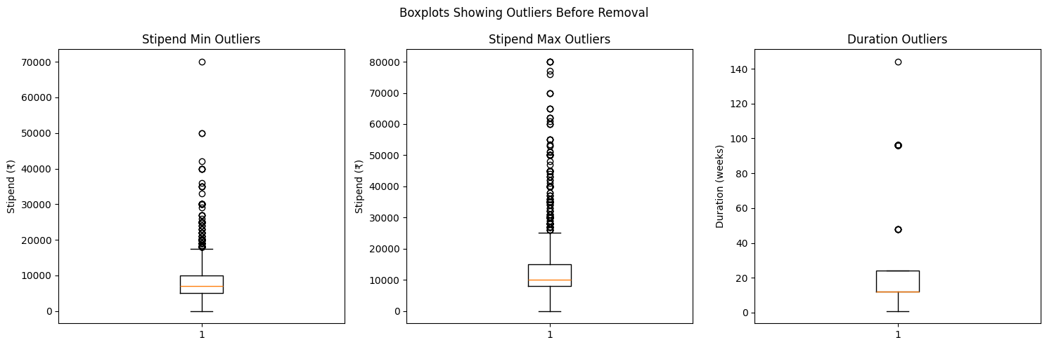
Outlier Detection & Treatment

Slide 39
Why this plot was used Boxplots were used to identify extreme values in selected numerical variables. Observations stipend_min has outliers going up to ₹70,000 — way above normal range stipend_max has outliers going up to ₹80,000 — even higher extreme values duration has outliers at 48, 96 and 144 weeks (1-3 years) — unrealistic for internships most data sits below ₹20,000 for stipend and below 24 weeks for duration IQR method will be used to remove these extreme values

Slide 40
EXPLORATORY DATA ANALYSIS (EDA)
EDA is performed to understand the dataset and identify patterns.
Types of analysis:
Univariate Analysis
Bivariate Analysis
Visualization using graphs

Slide 41
Univariate Analysis – Stipend
Univariate analysis is performed to study the distribution of stipend values.
A histogram is used to visualize how stipends are distributed across internships.
This helps identify common stipend ranges and outliers.

Slide 42
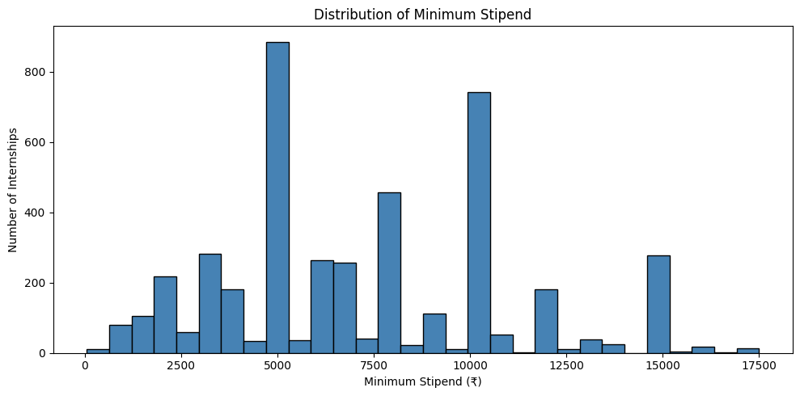

Slide 43
Why Histogram Histogram is used to show the frequency distribution of a continuous numerical variable. It helps understand how minimum stipend values are spread across all internships.

Slide 44
Observations
two major peaks at ₹5000 and ₹10000 — most common minimum stipend values
majority of internships offer minimum stipend between ₹5000 and ₹10000
very few internships offer above ₹15000 as minimum stipend
distribution is not smooth, internships are posted at fixed round number stipends

Slide 45
Univariate Analysis – Duration
The duration of internships is analyzed to understand how long most internships last.
A count plot is used to show the frequency of different durations.
This helps identify the most common internship durations.

Slide 46
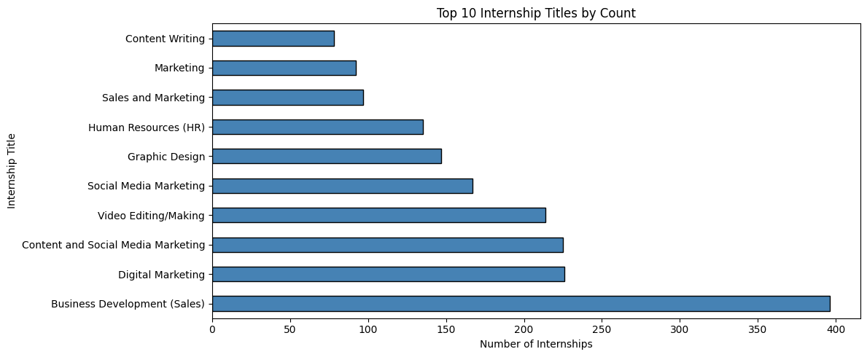
Top 10 Internship Titles by Count

Slide 47
Why Bar Chart
Bar chart is used to compare counts across different categories.
It helps identify which internship roles are most frequently posted on Internshala.

Slide 48
Observations
Business Development (Sales) is the most posted role by a large margin
Digital Marketing, Content and Social Media Marketing roles dominate the top 10
all top 10 roles are Non-IT, confirming non-technical internships are more common

Slide 49
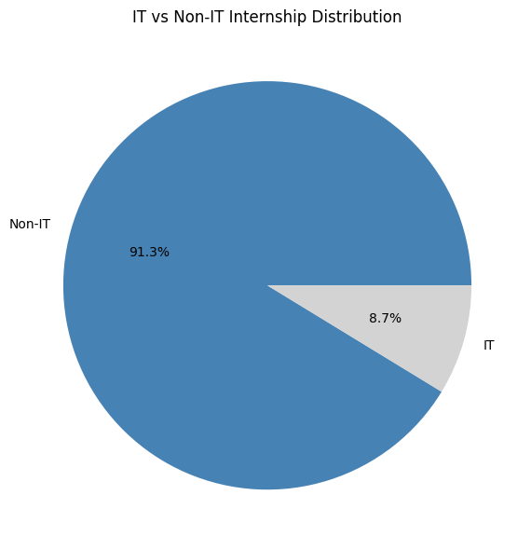
Pie Chart: IT vs Non-IT Distribution

Slide 50
Why Pie Chart
Pie chart is used to show proportion of two or more categories in a whole.
It helps understand what percentage of internships are IT vs Non-IT.

Slide 51
Observations
91.2% of internships are Non-IT — overwhelming majority
only 8.8% are IT internships
Internshala is heavily dominated by sales, marketing and creative roles

Slide 52
Bivariate Analysis – Stipend vs Location
This analysis examines how stipend varies across different locations.
By comparing stipend values for different cities, we can identify which locations offer higher-paying internships.

Slide 53
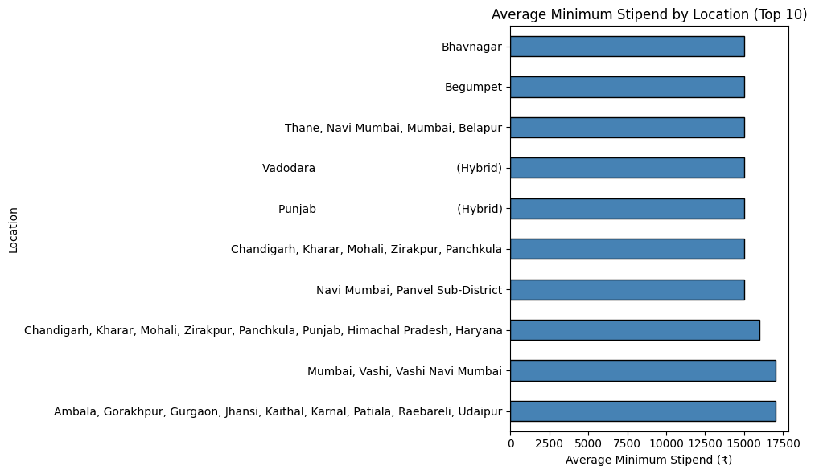

Slide 54
Why Horizontal Bar Chart
Horizontal bar chart is used when category names are long — easier to read than vertical bars.
It helps compare average minimum stipend across different locations.

Slide 55
Observations
top paying locations are mostly multi-city or specific area listings
Ambala, Gorakhpur combined listing pays highest average minimum stipend
single well known cities like Mumbai and Bangalore don't appear in top 10 alone
multi-city listings skew the location based stipend analysis

Slide 56
Bivariate Analysis – Stipend vs Duration
This analysis explores the relationship between internship duration and stipend.
It helps determine whether longer internships tend to offer higher pay compared to shorter ones.

Slide 57
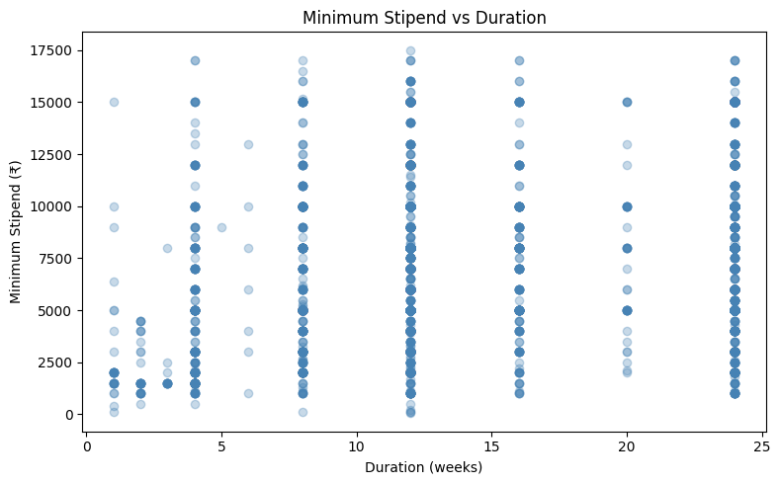

Slide 58
Why Scatter Plot
Scatter plot is used to show relationship between two continuous numerical variables.
It helps understand if longer internships tend to pay more.

Slide 59
Observations
no clear linear relationship between duration and minimum stipend
internships cluster at fixed durations like 4, 8, 12, 16, 24 weeks
stipend varies widely at every duration level
duration alone does not determine pay

Slide 60
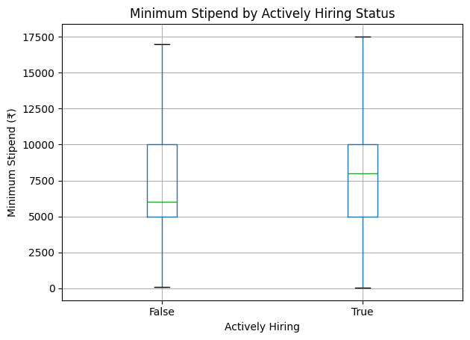
Stipend Min by Actively Hiring
<Figure size 600x500 with 0 Axes>

Slide 61
Why Boxplot
Boxplot is used to compare distribution of a numerical variable across categories.
It helps understand if actively hiring internships offer better stipends.

Slide 62
Observations
both actively hiring and non actively hiring internships show similar median stipend around ₹6000-₹8000
spread is similar for both groups
actively hiring status has no significant impact on stipend offered

Slide 63
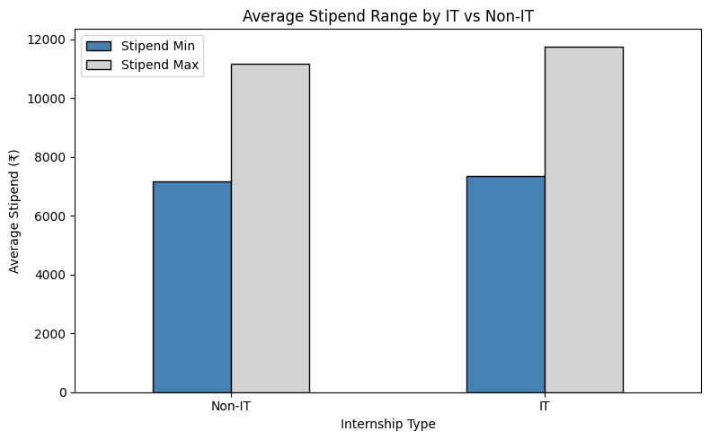
Multivariate Analysis - Average Stipend Min and Max by IT vs Non-IT

Slide 64
Why Grouped Bar Chart
Grouped bar chart is used to compare multiple numerical values across categories side by side.
It helps compare both minimum and maximum stipend between IT and Non-IT internships.

Slide 65
Observations
IT internships offer slightly higher minimum and maximum stipend than Non-IT
the difference is not dramatic — average minimum is ₹7400 IT vs ₹7200 Non-IT
maximum stipend gap is larger — IT reaches ₹11700 vs Non-IT ₹11100
IT roles have a wider pay range overall

Slide 66
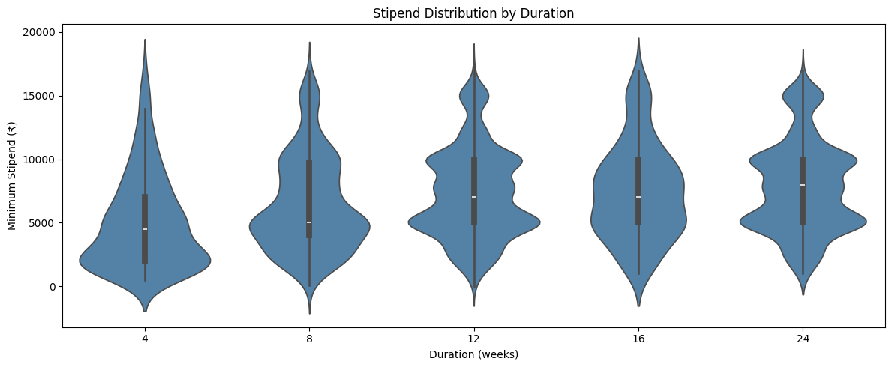
Violin Plot: Stipend Min by Duration Weeks

Slide 67
Why Violin Plot
Violin plot combines boxplot and distribution plot — shows both spread and shape of data.
It helps compare stipend distribution across the most common internship durations.

Slide 68
Observations
all durations show similar median stipend around ₹5000-₹8000
16 and 24 week internships show wider distribution — more variety in pay
4 week internships are narrower at the bottom — fewer high paying short internships
duration does not strongly determine stipend amount

Slide 69
DATA VISUALIZATION
Used Matplotlib to create:
Bar charts
Pie charts
Histograms
These visualizations help in better understanding of data trends.

Slide 70
Data Visualization Techniques
Various visualization techniques are used in this project, including bar charts, histograms, and count plots.
These visualizations make it easier to understand patterns and trends in the data.

Slide 71
Pivot Table
Pivot table summarizes data by grouping two categorical/discrete variables and calculating aggregate values.
It helps compare average minimum stipend across duration and IT vs Non-IT simultaneously.

Slide 72
Observations
IT internships consistently pay higher than Non-IT across all durations
longer durations generally show slightly higher stipend for IT roles
Non-IT stipend remains relatively flat regardless of duration

Slide 73
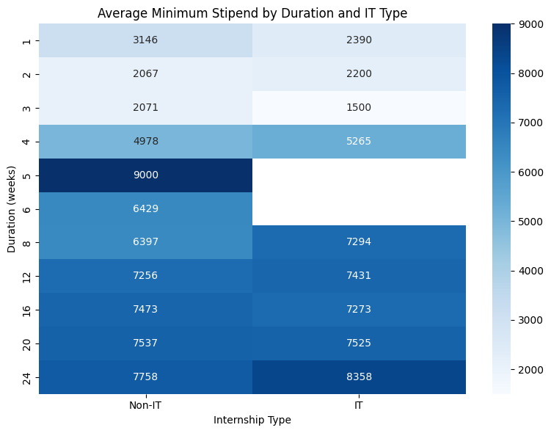
Pivot Table Heatmap

Slide 74
Why Heatmap
Heatmap gives a colour coded visual of the pivot table — easier to spot patterns than reading numbers.
Darker colour means higher stipend value.

Slide 75
Observations
IT internships at 24 weeks show highest average minimum stipend of ₹8305
Non-IT at 5 weeks shows unusually high ₹9000 — likely very few listings skewing the average
IT internships are consistently darker (higher pay) than Non-IT at longer durations
1, 2, 3 week internships are lightest — lowest paying regardless of IT or Non-IT

Slide 76
KEY INSIGHTS
From the analysis, several key insights are observed:
Certain cities offer higher stipends compared to others
Technical skills are associated with better pay
Internship duration has an impact on stipend levels

Slide 77
CHALLENGES FACED
Website structure changes
Handling missing data
Cleaning messy text data
Extracting correct HTML elements

Slide 78
CONCLUSION
In this project, we successfully collected real-world internship data using web scraping techniques.
The dataset was cleaned and analyzed using exploratory data analysis methods.
Meaningful insights were derived regarding stipend trends, locations, and skills.
This project demonstrates the practical application of data analysis in solving real-world problems.

Slide 79

THANK YOU

